Slide 1

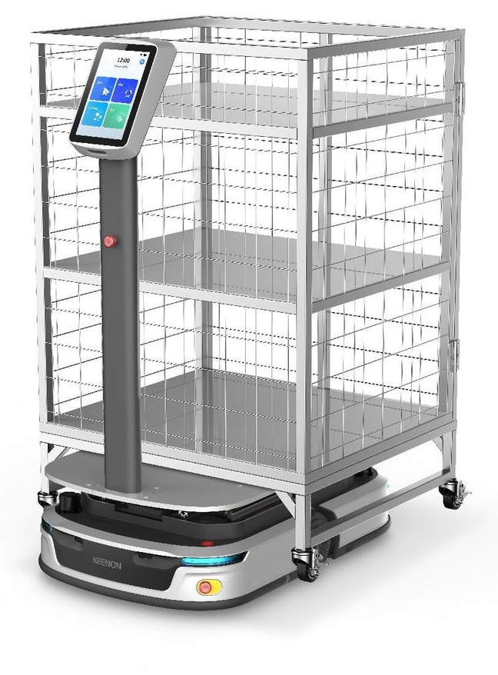
DATASHEET-S300
Heavy-load Delivery Robot
S300
Key Features
Heavy-load Delivery Ability： Capable of 300kg objects lifting and transporting.
Vslam Development : Utilizing multiple sensors and modules, including dual LiDAR, tri-stereo vision, and image modules, to enhance localization accuracy.
360° Obstacle Detection and Avoidance: Capable of accurately identifying and avoiding low-lying and suspended obstacles, ensuring safe movement of the robot.
Human-Robot Coexistence: Providing ultimate safety assurance in environments where humans and robots coexist, ensuring secure interaction between humans and machines.
IoT Connection with Essential Facilities: Support lift taking , passing through automatic doors, and support the integration of complete call systems.
7*24H Working：15-second battery swap for uninterrupted 24/7 delivery，supports auto, manual charging and battery swap for diverse operational needs.
Stability and Maneuverability: The machine exhibits exceptional stability and maneuverability, adapting to various complex terrain environments to ensure smooth motion.
Specifications
Performance
Robot Dimension | 925mm*620mm*1282mm
Load Capacity | 300kg
Minimum Passage Width | 900mm（without rotation）；1100mm(able to turn around)
Maximum Compatible Shelf Size | 1200mm*1200mm
Standard Shelf Size | 800mm*850mm
Lifting Height | 5cm
Lifting Time | 6s
Moving Speed (Unloaded) | 0.2~1m/s
Moving Speed (Fully Loaded) | 0.2~0.8m/s
Robotic Travel Direction | Unidirectional Travel
Rotation Capability | 360° rotation in place
Multi-robot Collaboration | 10 robots
Slope Angle | ≤ 5°
Precise Docking Accuracy | 2-3cm（shelf points，charging points and other special points）
Gap Crossing Ability | ≤30mm
Obstacle Crossing Ability | ≤10mm
Chassis Ground Clearance | ≤25mm (safe for normal footwear)
1

Slide 2

DATASHEET-S300
Environment
Operating Temperature and Humidity | 0 - 45℃, RH：5％～95%
Operating Environment | Indoor environment, flat ground, no dust
Storage Temperature | -20-50℃
Battery and Charging
Battery Life | 6h (<300kg)
Charging Time | 3.5h (0-100%)
Battery Type | Ternary lithium battery
Battery Capacity | DC48V15Ah
Battery Dismountable | Yes
Charging Mode | Automatic charging with charging pile, manual charging by recharger and battery Swap
Charging Input | 100-240V~,3.5A(MAX.)50/60Hz
Charging Output | 54.6V,5A
Charging Pile Dimension（W*D*H） | 220mm*146mm*305mm
Hardware
Machine Material | ABS & aluminum alloy
Robot Weight | 115KG
Positioning Method | Vslam
Sensing Techniques | Lidar, Image module, Stereo vision, Collision sensor, IMU
Emergency Stop Button | Front, Side, Rear
Network | Wi-Fi/4G
Touch Screen | 10.1inch(1280*800)
Interactive Ability | Light/Touch/Voice Prompt
WIFI | 802.11b/g/n transmission
WIFI Frequency | 2.4-2.484GHZ
LoRa Frequency | 850.125MHz~930.125MHz
System and Function
System | Linux(Control) & Android(Interaction)
App Language | Chinese, English, Japanese, Korean, Thai, Traditional Chinese, French, German
App Functions | Direct delivery, Multi-point delivery, Cycle , Lift , Follow mode
Voice Reminder | Different voice prompt in different working mode and general operation.
2

Slide 3
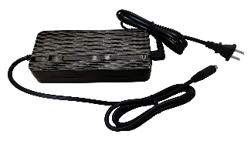
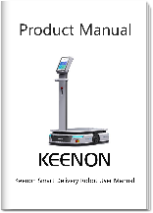
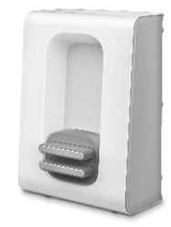
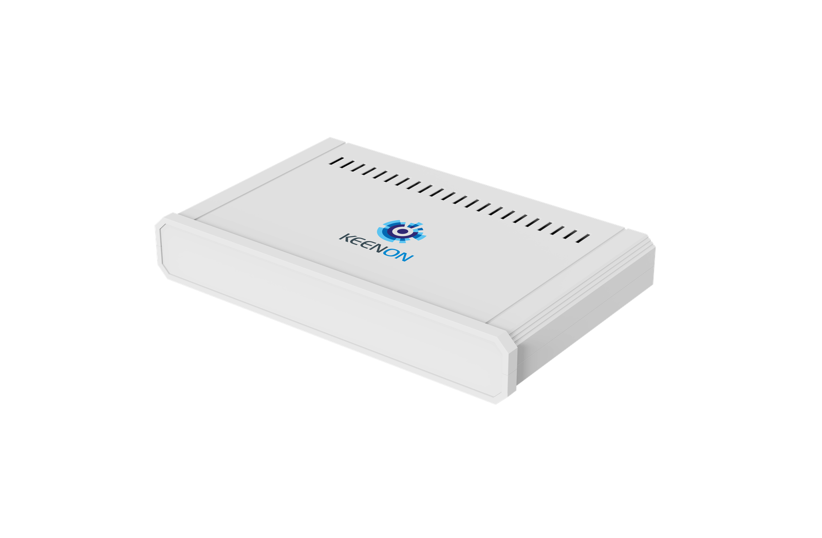
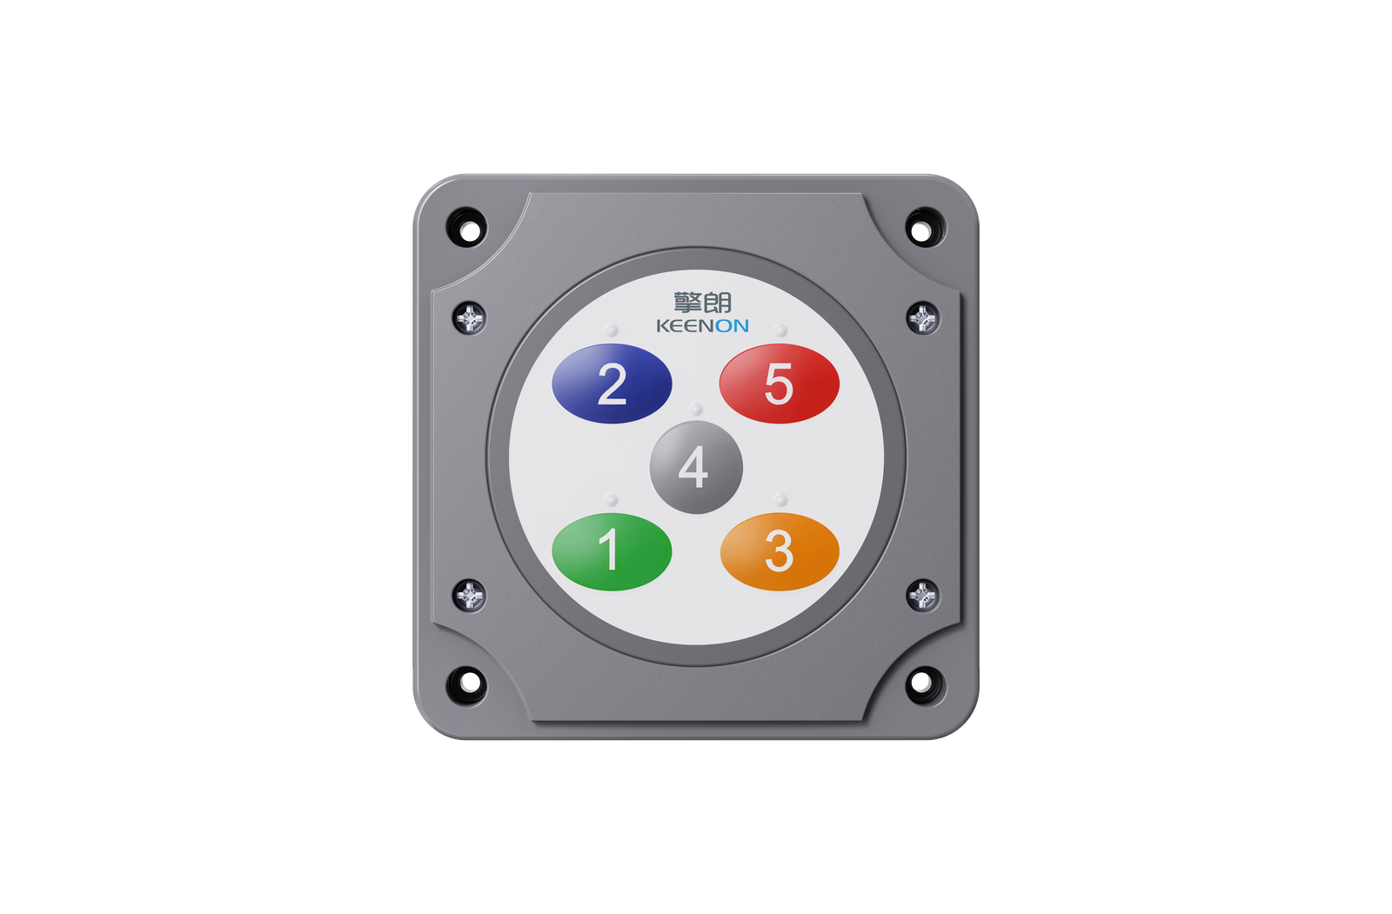
DATASHEET
DATASHEET-S300
Official Standard and Optional Parts
Package Main Contents | Robot*1, Battery Recharger*1, Charging Pile, Product Manual*1
Optional Part | Calling System
Package Content
Battery Recharger*1
Product Manual*1
Charging Pile*1
*The actual recharger may be different.
Optional Parts
Call Button
Control Center
3

